Slide 1
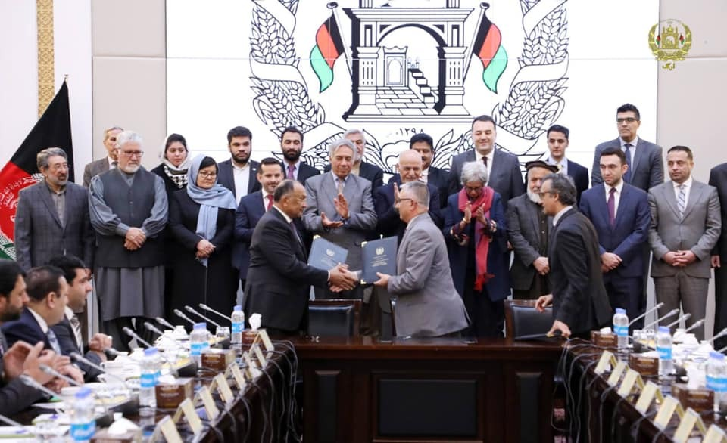
In AFGHANISTAN

Slide 2
Contents
Why PPPs in Afghanistan?
Background
Involved authorities
CPA’s role
Some achievements in Parts of PPPs in the country
Government and International community’s support to PPPs in the country
Examples of different types of supports given to the projects so far
2

Slide 3
Why PPPs in Afghanistan?
Underinvestment and poor maintenance have left Afghanistan with a significant deficit in all forms of infrastructure and public services holding back the country’s development and economic growth;
Given the increasing demand for infrastructure development, services and the need for significant level of investment, capacity and resources requirements, the Government recognizes the need to augment its efforts and scarce resources through increased private sector participation.
National Budget Deficit
Different Competencies and skills available with both public and private parties
Efficiency
Accountability
Transfer of advanced technology to the country and boosting economic growth in the country
2

Slide 4
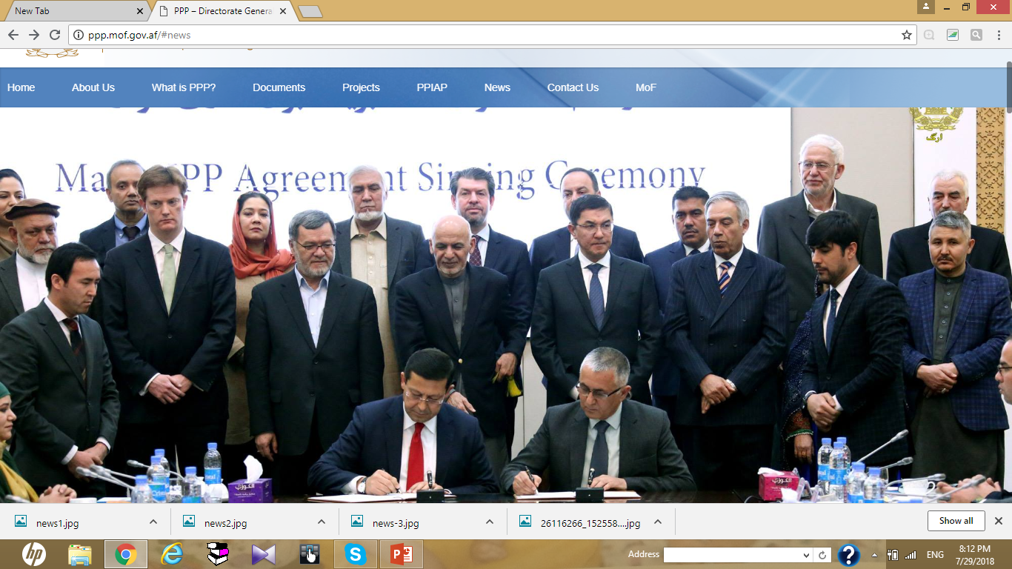
PPPs Background in Afghanistan
The General Directorate of Public-Private Partnership , Central Partnership Authority was established based on the decision of High Economic Council in 2015, and the decree No. 1650 dated 8/19/2016 of the HE the President of Afghanistan.
۱

Slide 5
Main authorities involved in PPPs
Cabinet
High Economic Council
Entities
DG-PPP(CPA)
Ministry of Finance
3

Slide 6
Central Partnership Authority’s main responsibilities
Policy / Legal framework Making
Technical support to entities
Stakeholders Engagement
documents standardization
CPA
Market testing and market sounding
Facilitating approvals and supports to the project
Ensuring Transparency accountability
PPP Projects Monitoring
2

Slide 7
Achievements
PPP Legal framework
PPP National policy
PPP Law
PPP regulation
PPP general rules of procedure
PPP guidelines
Standard documents
Note: These were developed with Harakat’s support
PPP awarded projects
Kandahar 15 MW solar project
Kandahar 15 MW solar project
Kajaki Dam 2nd stage
Balkh Gas to power project
Bayat gas to power project
Badakhshan power supply
Water supply to districts 12 &22
Kandahar 10 MW solar project
Total Value: US$1028.89 million
Projects in procurement stage worth a total of $547.39 million
16 Projects ready for investment, worth a total of $3.1 billion
4

Slide 8
Government supports
Viability Gap Fund (VGF)
Project Development Fund (PDF)
Tax and Custom break,
Tax holidays,
Streamlining of the licensing process,
Concession rights to private partners in PPPs
Insurance coverage
Land facilities
Deferent types of Guarantees
Protection from nationalization, expropriation and property rights; exchange and transfer of foreign currency and compensation of the state’s legal liabilities to a private partner.
5

Slide 9
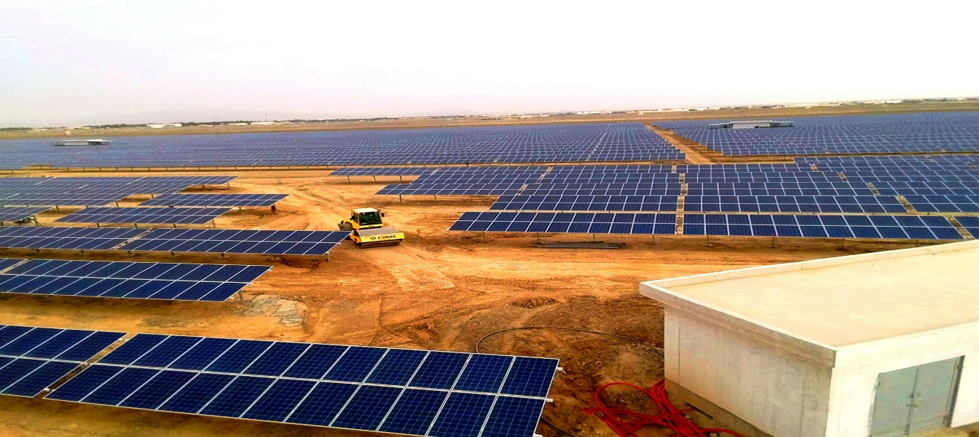
Kandahar 15 MW Solar project
BOT
$19.5million invested by Company 77 in Kandahar
Payment of US $ 7 million as Viability Gap Fund
Politician and Non-Political Force Majeure
6

Slide 10
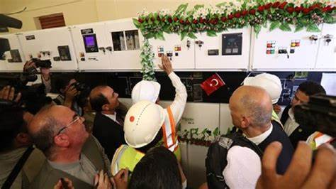
Kandahar 15 MW Solar Energy Project
BOT
$ 19.5million invested by Zolarestan company in Kandahar
Payment of US $ 7 million as Viability Gap Fund
Politician and Non-Political Force Majeure
7
Notes:
IDA grantee is world bank guarantee partial less guarantee to cover government’s liabilities
SBLC stand by letter of credit

Slide 11
Kandahar 10 MW Solar Energy Project
BOT
$16million invested in Kandahar by Dynasty
Payment of $10 million Viability Gap Fund
Politician and Non-Political Force Majeure
9

Slide 12
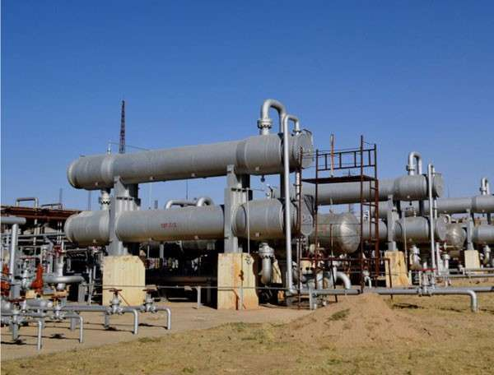
Bayat Gas to Power Energy project in Jawzjan
BOO
U$38million invested by Bayat Company in Sheberghan
1. Providing guarantee worth 13 million US $ to Jawzjan electricity project.
2. Advance Tax exemption
3. IDA guarantee
8

Slide 13
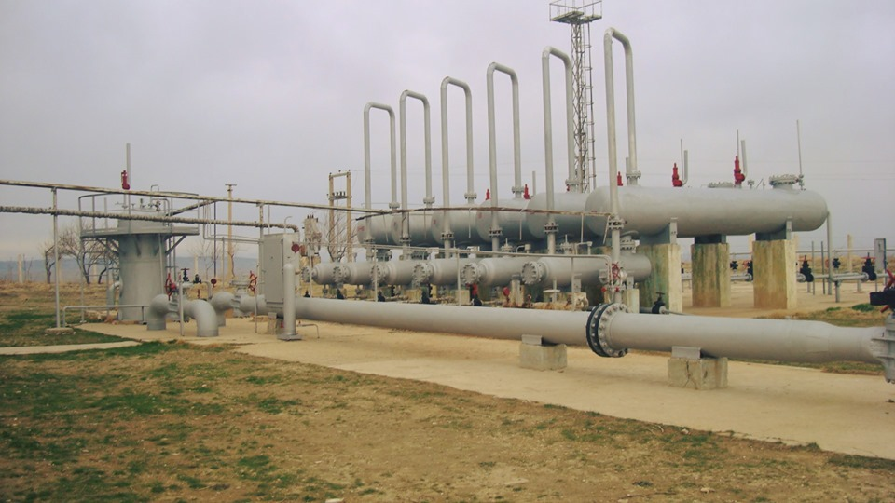
Balkh Gas to power Energy Project
BOO
US$75.3million invested by Afghanistan Power Plant
Providing guarantee worth 5 million US $
IDA Guarantee,
Politician and Non-Political Force Majeure
10

Slide 14
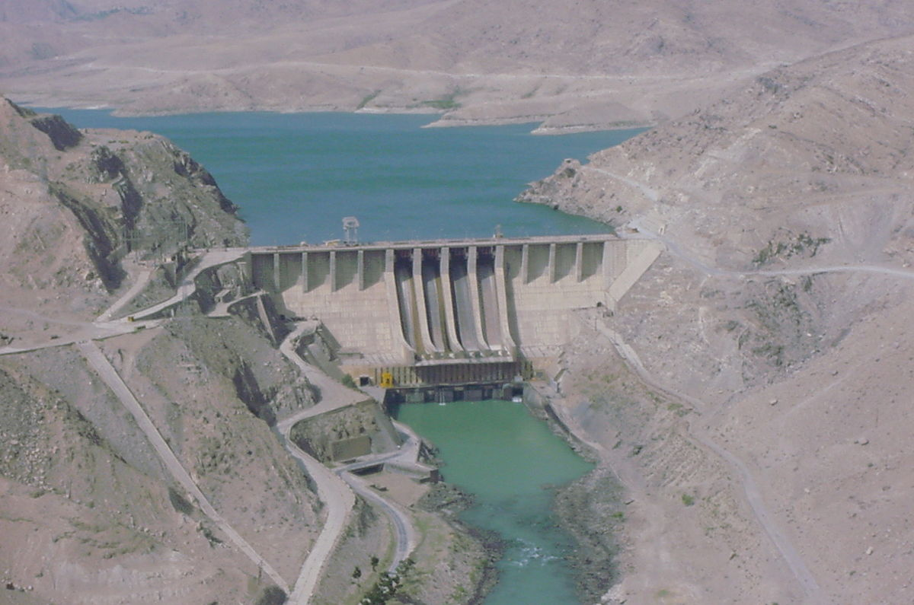
Kajaki Dam Project
DBFO
$174.9million invested by 77 Helmand Province
1. Sovereign Guarantee,
2. Politician and Non-Political Force Majeure,
3. IDA Guarantee
11

Slide 15
Kabul Water Supply to districts 12 &22 Project
DBFO
$54million Kabul district 12 and 22
1. Politician and Non-Political Force Majeure,
11

Slide 16
Badakhshan Province Electrification Project
DBFO
$631million By Agha Khan Foundation in Badakhshan Province
1. Politician and Non-Political Force Majeure,
2.Land and government’s assits
11

Slide 17
Key steps to prepare a PPP project
12

Slide 18
Welcoming You to PPP Opportunities Detailed Presentations …

